Slide 1
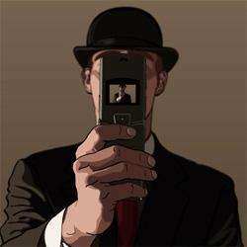
Pixels and Image Filtering
02/01/11
Computer Vision
Derek Hoiem, University of Illinois
Graphic: http://www.notcot.org/post/4068/

Slide 2
Today’s Class: Pixels and Linear Filters
Review of lighting
Reflection and absorption
What is a pixel? How is an image represented?
Color spaces
What is image filtering and how do we do it?

Slide 3
A photon’s life choices
Absorption
Diffusion
Reflection
Transparency
Refraction
Fluorescence
Subsurface scattering
Phosphorescence
Interreflection
light source
λ
?

Slide 4
A photon’s life choices
Absorption
Diffusion
Reflection
Transparency
Refraction
Fluorescence
Subsurface scattering
Phosphorescence
Interreflection
light source
λ

Slide 5
A photon’s life choices
Absorption
Diffuse Reflection
Reflection
Transparency
Refraction
Fluorescence
Subsurface scattering
Phosphorescence
Interreflection
light source
λ

Slide 6
A photon’s life choices
Absorption
Diffusion
Specular Reflection
Transparency
Refraction
Fluorescence
Subsurface scattering
Phosphorescence
Interreflection
light source
λ

Slide 7
A photon’s life choices
Absorption
Diffusion
Reflection
Transparency
Refraction
Fluorescence
Subsurface scattering
Phosphorescence
Interreflection
light source
λ

Slide 8
A photon’s life choices
Absorption
Diffusion
Reflection
Transparency
Refraction
Fluorescence
Subsurface scattering
Phosphorescence
Interreflection
light source
λ

Slide 9
A photon’s life choices
Absorption
Diffusion
Reflection
Transparency
Refraction
Fluorescence
Subsurface scattering
Phosphorescence
Interreflection
light source
λ₁
λ₂

Slide 10
A photon’s life choices
Absorption
Diffusion
Reflection
Transparency
Refraction
Fluorescence
Subsurface scattering
Phosphorescence
Interreflection
light source
λ

Slide 11
A photon’s life choices
Absorption
Diffusion
Reflection
Transparency
Refraction
Fluorescence
Subsurface scattering
Phosphorescence
Interreflection
light source
t=1
t=n

Slide 12
A photon’s life choices
Absorption
Diffusion
Reflection
Transparency
Refraction
Fluorescence
Subsurface scattering
Phosphorescence
Interreflection
light source
λ
(Specular Interreflection)

Slide 13
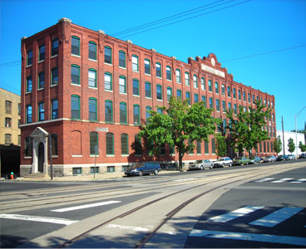
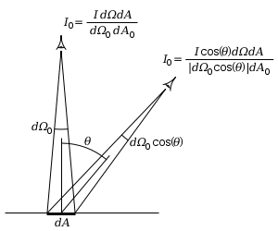
Surface orientation and light intensity
1
2
Why is (1) darker than (2)?
For diffuse reflection, will intensity change when viewing angle changes?
Notes:
Show why viewing direction doesn’t change intensity.

Slide 14
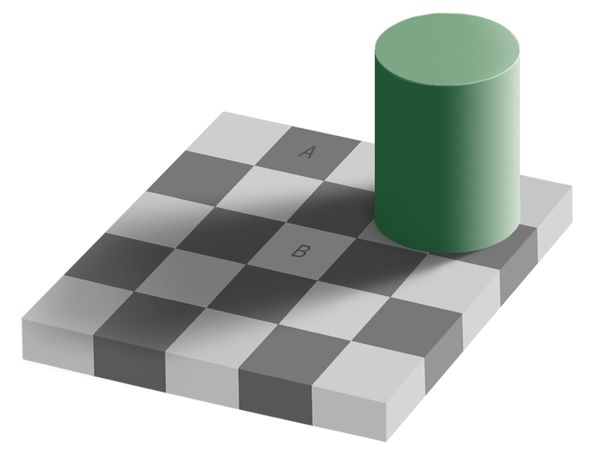
Perception of Intensity
from Ted Adelson

Slide 15
Perception of Intensity
from Ted Adelson

Slide 16

Image Formation

Slide 17
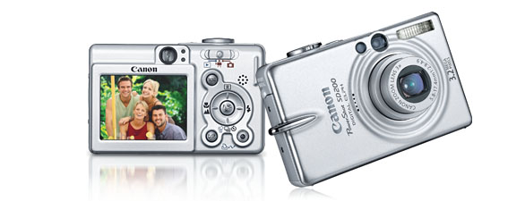
Digital camera
A digital camera replaces film with a sensor array
Each cell in the array is light-sensitive diode that converts photons to electrons
Two common types: Charge Coupled Device (CCD) and CMOS
http://electronics.howstuffworks.com/digital-camera.htm
Slide by Steve Seitz

Slide 18
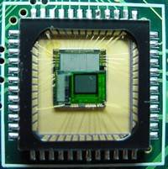

Sensor Array
CMOS sensor

Slide 19
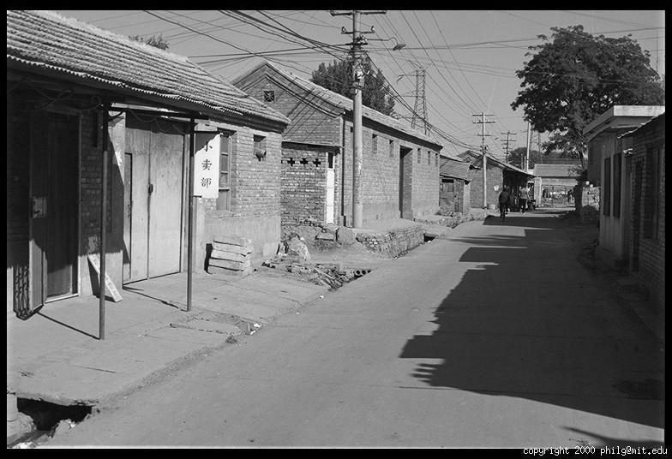
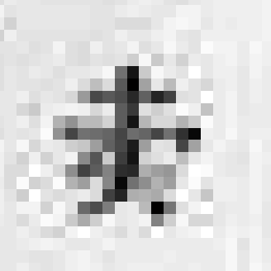
The raster image (pixel matrix)

Slide 20
The raster image (pixel matrix)
0.92 | 0.93 | 0.94 | 0.97 | 0.62 | 0.37 | 0.85 | 0.97 | 0.93 | 0.92 | 0.99
0.95 | 0.89 | 0.82 | 0.89 | 0.56 | 0.31 | 0.75 | 0.92 | 0.81 | 0.95 | 0.91
0.89 | 0.72 | 0.51 | 0.55 | 0.51 | 0.42 | 0.57 | 0.41 | 0.49 | 0.91 | 0.92
0.96 | 0.95 | 0.88 | 0.94 | 0.56 | 0.46 | 0.91 | 0.87 | 0.90 | 0.97 | 0.95
0.71 | 0.81 | 0.81 | 0.87 | 0.57 | 0.37 | 0.80 | 0.88 | 0.89 | 0.79 | 0.85
0.49 | 0.62 | 0.60 | 0.58 | 0.50 | 0.60 | 0.58 | 0.50 | 0.61 | 0.45 | 0.33
0.86 | 0.84 | 0.74 | 0.58 | 0.51 | 0.39 | 0.73 | 0.92 | 0.91 | 0.49 | 0.74
0.96 | 0.67 | 0.54 | 0.85 | 0.48 | 0.37 | 0.88 | 0.90 | 0.94 | 0.82 | 0.93
0.69 | 0.49 | 0.56 | 0.66 | 0.43 | 0.42 | 0.77 | 0.73 | 0.71 | 0.90 | 0.99
0.79 | 0.73 | 0.90 | 0.67 | 0.33 | 0.61 | 0.69 | 0.79 | 0.73 | 0.93 | 0.97
0.91 | 0.94 | 0.89 | 0.49 | 0.41 | 0.78 | 0.78 | 0.77 | 0.89 | 0.99 | 0.93

Slide 21
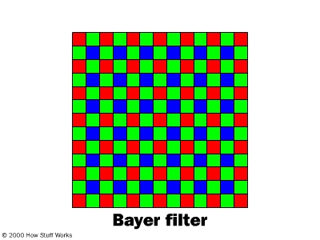
Digital Color Images

Slide 22
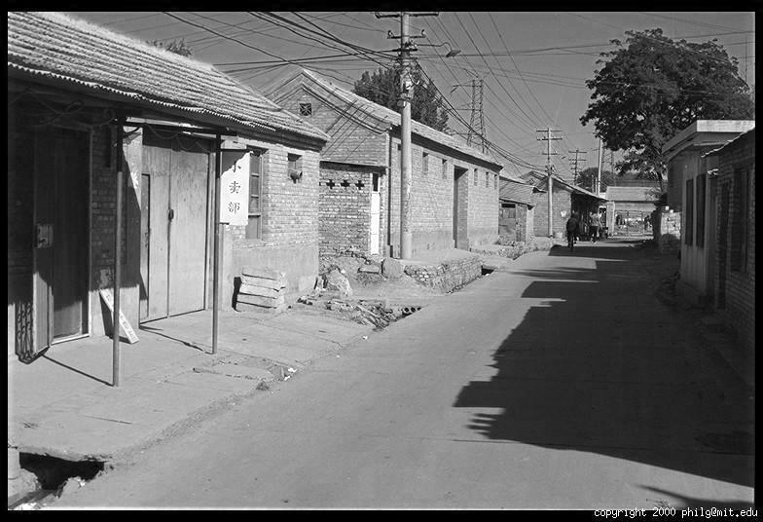
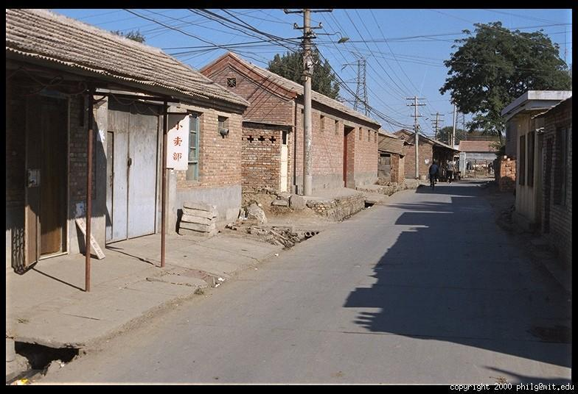
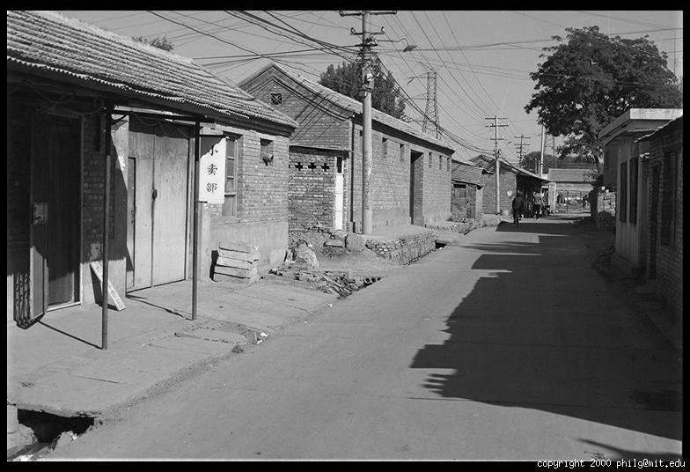
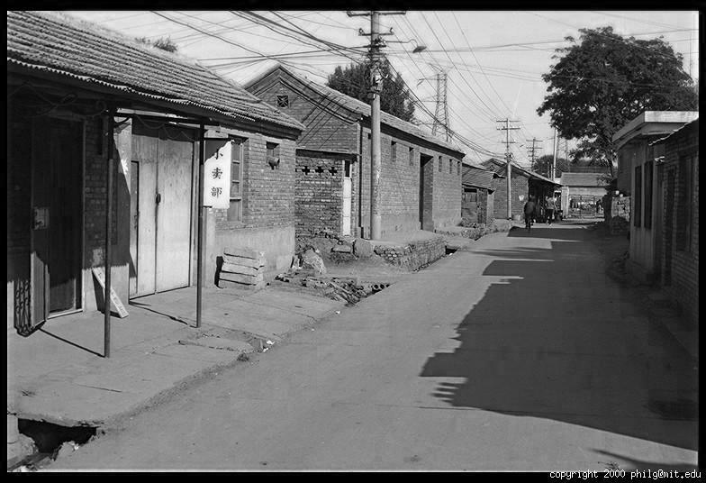
Color Image
R
G
B

Slide 23
Images in Matlab
Images represented as a matrix
Suppose we have a NxM RGB image called “im”
im(1,1,1) = top-left pixel value in R-channel
im(y, x, b) = y pixels down, x pixels to right in the b^{th} channel
im(N, M, 3) = bottom-right pixel in B-channel
imread(filename) returns a uint8 image (values 0 to 255)
Convert to double format (values 0 to 1) with im2double
column
row
R
0.92 | 0.93 | 0.94 | 0.97 | 0.62 | 0.37 | 0.85 | 0.97 | 0.93 | 0.92 | 0.99
0.95 | 0.89 | 0.82 | 0.89 | 0.56 | 0.31 | 0.75 | 0.92 | 0.81 | 0.95 | 0.91
0.89 | 0.72 | 0.51 | 0.55 | 0.51 | 0.42 | 0.57 | 0.41 | 0.49 | 0.91 | 0.92
0.96 | 0.95 | 0.88 | 0.94 | 0.56 | 0.46 | 0.91 | 0.87 | 0.90 | 0.97 | 0.95
0.71 | 0.81 | 0.81 | 0.87 | 0.57 | 0.37 | 0.80 | 0.88 | 0.89 | 0.79 | 0.85
0.49 | 0.62 | 0.60 | 0.58 | 0.50 | 0.60 | 0.58 | 0.50 | 0.61 | 0.45 | 0.33
0.86 | 0.84 | 0.74 | 0.58 | 0.51 | 0.39 | 0.73 | 0.92 | 0.91 | 0.49 | 0.74
0.96 | 0.67 | 0.54 | 0.85 | 0.48 | 0.37 | 0.88 | 0.90 | 0.94 | 0.82 | 0.93
0.69 | 0.49 | 0.56 | 0.66 | 0.43 | 0.42 | 0.77 | 0.73 | 0.71 | 0.90 | 0.99
0.79 | 0.73 | 0.90 | 0.67 | 0.33 | 0.61 | 0.69 | 0.79 | 0.73 | 0.93 | 0.97
0.91 | 0.94 | 0.89 | 0.49 | 0.41 | 0.78 | 0.78 | 0.77 | 0.89 | 0.99 | 0.93
G
0.92 | 0.93 | 0.94 | 0.97 | 0.62 | 0.37 | 0.85 | 0.97 | 0.93 | 0.92 | 0.99
0.95 | 0.89 | 0.82 | 0.89 | 0.56 | 0.31 | 0.75 | 0.92 | 0.81 | 0.95 | 0.91
0.89 | 0.72 | 0.51 | 0.55 | 0.51 | 0.42 | 0.57 | 0.41 | 0.49 | 0.91 | 0.92
0.96 | 0.95 | 0.88 | 0.94 | 0.56 | 0.46 | 0.91 | 0.87 | 0.90 | 0.97 | 0.95
0.71 | 0.81 | 0.81 | 0.87 | 0.57 | 0.37 | 0.80 | 0.88 | 0.89 | 0.79 | 0.85
0.49 | 0.62 | 0.60 | 0.58 | 0.50 | 0.60 | 0.58 | 0.50 | 0.61 | 0.45 | 0.33
0.86 | 0.84 | 0.74 | 0.58 | 0.51 | 0.39 | 0.73 | 0.92 | 0.91 | 0.49 | 0.74
0.96 | 0.67 | 0.54 | 0.85 | 0.48 | 0.37 | 0.88 | 0.90 | 0.94 | 0.82 | 0.93
0.69 | 0.49 | 0.56 | 0.66 | 0.43 | 0.42 | 0.77 | 0.73 | 0.71 | 0.90 | 0.99
0.79 | 0.73 | 0.90 | 0.67 | 0.33 | 0.61 | 0.69 | 0.79 | 0.73 | 0.93 | 0.97
0.91 | 0.94 | 0.89 | 0.49 | 0.41 | 0.78 | 0.78 | 0.77 | 0.89 | 0.99 | 0.93
B
0.92 | 0.93 | 0.94 | 0.97 | 0.62 | 0.37 | 0.85 | 0.97 | 0.93 | 0.92 | 0.99
0.95 | 0.89 | 0.82 | 0.89 | 0.56 | 0.31 | 0.75 | 0.92 | 0.81 | 0.95 | 0.91
0.89 | 0.72 | 0.51 | 0.55 | 0.51 | 0.42 | 0.57 | 0.41 | 0.49 | 0.91 | 0.92
0.96 | 0.95 | 0.88 | 0.94 | 0.56 | 0.46 | 0.91 | 0.87 | 0.90 | 0.97 | 0.95
0.71 | 0.81 | 0.81 | 0.87 | 0.57 | 0.37 | 0.80 | 0.88 | 0.89 | 0.79 | 0.85
0.49 | 0.62 | 0.60 | 0.58 | 0.50 | 0.60 | 0.58 | 0.50 | 0.61 | 0.45 | 0.33
0.86 | 0.84 | 0.74 | 0.58 | 0.51 | 0.39 | 0.73 | 0.92 | 0.91 | 0.49 | 0.74
0.96 | 0.67 | 0.54 | 0.85 | 0.48 | 0.37 | 0.88 | 0.90 | 0.94 | 0.82 | 0.93
0.69 | 0.49 | 0.56 | 0.66 | 0.43 | 0.42 | 0.77 | 0.73 | 0.71 | 0.90 | 0.99
0.79 | 0.73 | 0.90 | 0.67 | 0.33 | 0.61 | 0.69 | 0.79 | 0.73 | 0.93 | 0.97
0.91 | 0.94 | 0.89 | 0.49 | 0.41 | 0.78 | 0.78 | 0.77 | 0.89 | 0.99 | 0.93

Slide 24
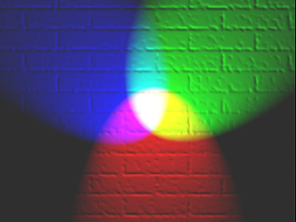
Color spaces
How can we represent color?
http://en.wikipedia.org/wiki/File:RGB_illumination.jpg

Slide 25

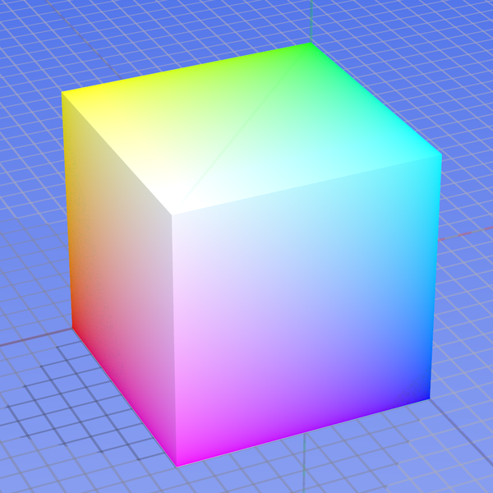
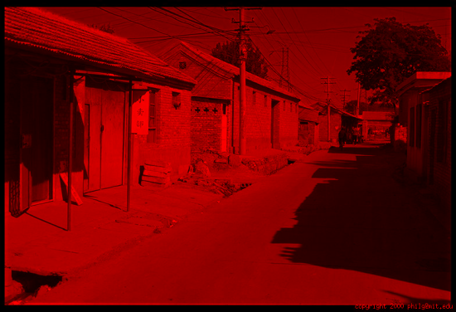
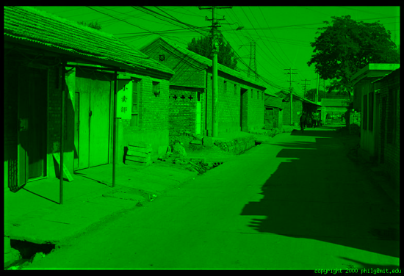
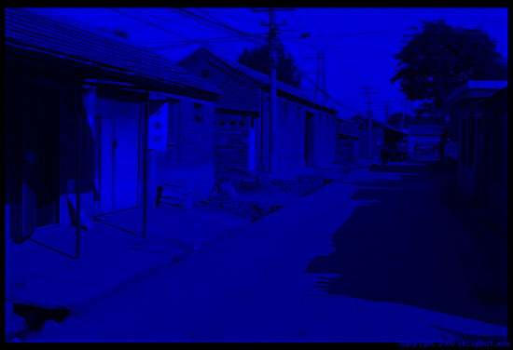
Color spaces: RGB
Default color space
0,1,0
R
(G=0,B=0)
1,0,0
G
(R=0,B=0)
0,0,1
B
(R=0,G=0)
Some drawbacks
Strongly correlated channels
Non-perceptual
Image from: http://en.wikipedia.org/wiki/File:RGB_color_solid_cube.png

Slide 26
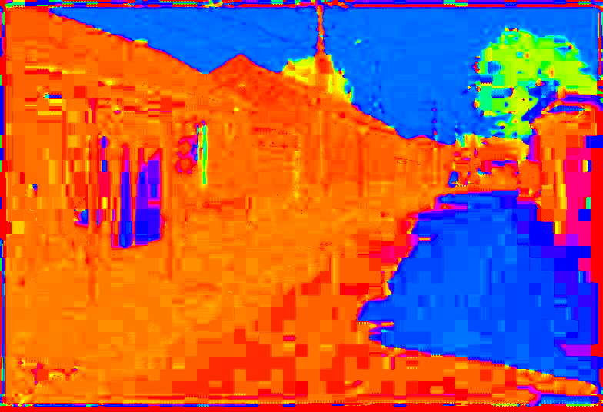
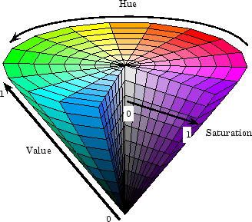
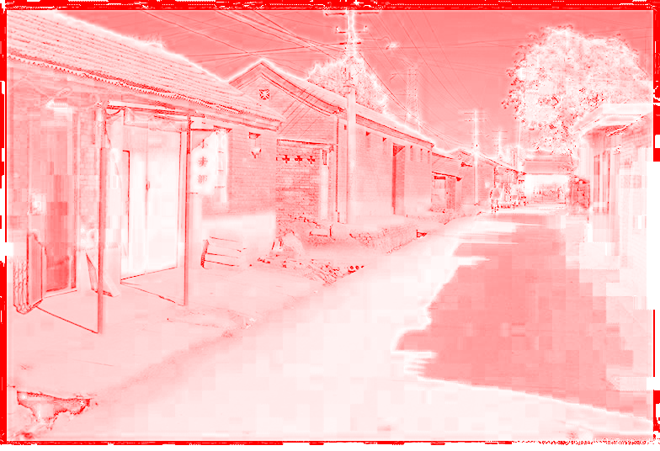
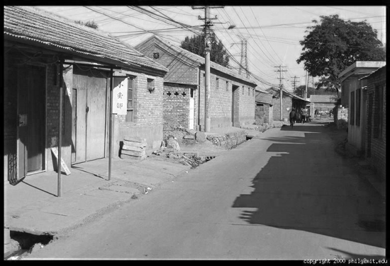
Color spaces: HSV
Intuitive color space
H
(S=1,V=1)
S
(H=1,V=1)
V
(H=1,S=0)

Slide 27
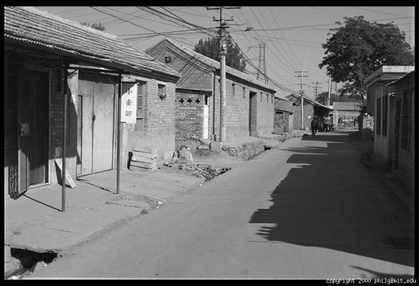





Color spaces: YCbCr
Fast to compute, good for compression, used by TV
Y=0
Y=0.5
Y
(Cb=0.5,Cr=0.5)
Cr
Cb
(Y=0.5,Cr=0.5)
Cb
Y=1
Cr
(Y=0.5,Cb=05)

Slide 28

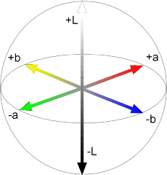
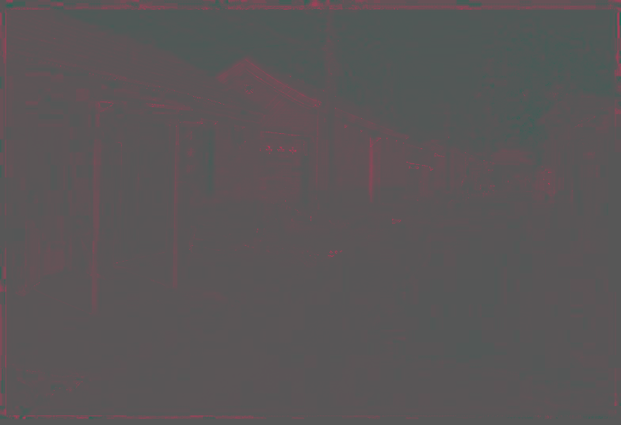
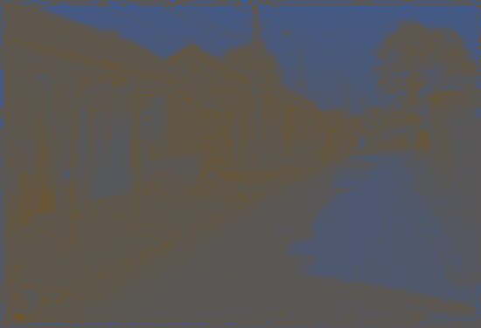
Color spaces: L*a*b*
“Perceptually uniform” color space
L
(a=0,b=0)
a
(L=65,b=0)
b
(L=65,a=0)

Slide 29
If you had to choose, would you rather go without luminance or chrominance?

Slide 30
If you had to choose, would you rather go without luminance or chrominance?

Slide 31
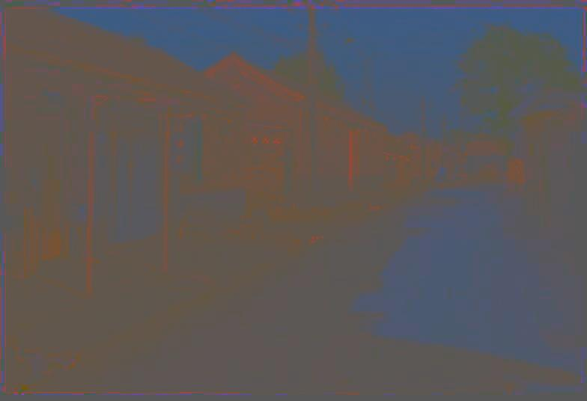
Most information in intensity
Only color shown – constant intensity

Slide 32
Most information in intensity
Only intensity shown – constant color

Slide 33
Most information in intensity
Original image

Slide 34
Back to grayscale intensity
0.92 | 0.93 | 0.94 | 0.97 | 0.62 | 0.37 | 0.85 | 0.97 | 0.93 | 0.92 | 0.99
0.95 | 0.89 | 0.82 | 0.89 | 0.56 | 0.31 | 0.75 | 0.92 | 0.81 | 0.95 | 0.91
0.89 | 0.72 | 0.51 | 0.55 | 0.51 | 0.42 | 0.57 | 0.41 | 0.49 | 0.91 | 0.92
0.96 | 0.95 | 0.88 | 0.94 | 0.56 | 0.46 | 0.91 | 0.87 | 0.90 | 0.97 | 0.95
0.71 | 0.81 | 0.81 | 0.87 | 0.57 | 0.37 | 0.80 | 0.88 | 0.89 | 0.79 | 0.85
0.49 | 0.62 | 0.60 | 0.58 | 0.50 | 0.60 | 0.58 | 0.50 | 0.61 | 0.45 | 0.33
0.86 | 0.84 | 0.74 | 0.58 | 0.51 | 0.39 | 0.73 | 0.92 | 0.91 | 0.49 | 0.74
0.96 | 0.67 | 0.54 | 0.85 | 0.48 | 0.37 | 0.88 | 0.90 | 0.94 | 0.82 | 0.93
0.69 | 0.49 | 0.56 | 0.66 | 0.43 | 0.42 | 0.77 | 0.73 | 0.71 | 0.90 | 0.99
0.79 | 0.73 | 0.90 | 0.67 | 0.33 | 0.61 | 0.69 | 0.79 | 0.73 | 0.93 | 0.97
0.91 | 0.94 | 0.89 | 0.49 | 0.41 | 0.78 | 0.78 | 0.77 | 0.89 | 0.99 | 0.93

Slide 35
Next three classes: three views of filtering
Image filters in spatial domain
Filter is a mathematical operation of a grid of numbers
Smoothing, sharpening, measuring texture
Image filters in the frequency domain
Filtering is a way to modify the frequencies of images
Denoising, sampling, image compression
Templates and Image Pyramids
Filtering is a way to match a template to the image
Detection, coarse-to-fine registration

Slide 36
Image filtering
Image filtering: compute function of local neighborhood at each position
Really important!
Enhance images
Denoise, resize, increase contrast, etc.
Extract information from images
Texture, edges, distinctive points, etc.
Detect patterns
Template matching

Slide 37

Example: box filter
1
1
1
1
1
1
1
1
1
Slide credit: David Lowe (UBC)

Slide 38
Image filtering
1
1
1
1
1
1
1
1
1
0 | 0 | 0 | 0 | 0 | 0 | 0 | 0 | 0 | 0
0 | 0 | 0 | 0 | 0 | 0 | 0 | 0 | 0 | 0
0 | 0 | 0 | 90 | 90 | 90 | 90 | 90 | 0 | 0
0 | 0 | 0 | 90 | 90 | 90 | 90 | 90 | 0 | 0
0 | 0 | 0 | 90 | 90 | 90 | 90 | 90 | 0 | 0
0 | 0 | 0 | 90 | 0 | 90 | 90 | 90 | 0 | 0
0 | 0 | 0 | 90 | 90 | 90 | 90 | 90 | 0 | 0
0 | 0 | 0 | 0 | 0 | 0 | 0 | 0 | 0 | 0
0 | 0 | 90 | 0 | 0 | 0 | 0 | 0 | 0 | 0
0 | 0 | 0 | 0 | 0 | 0 | 0 | 0 | 0 | 0
 | 0
0 | 0 | 0 | 0 | 0 | 0 | 0 | 0 | 0 | 0
0 | 0 | 0 | 0 | 0 | 0 | 0 | 0 | 0 | 0
0 | 0 | 0 | 90 | 90 | 90 | 90 | 90 | 0 | 0
0 | 0 | 0 | 90 | 90 | 90 | 90 | 90 | 0 | 0
0 | 0 | 0 | 90 | 90 | 90 | 90 | 90 | 0 | 0
0 | 0 | 0 | 90 | 0 | 90 | 90 | 90 | 0 | 0
0 | 0 | 0 | 90 | 90 | 90 | 90 | 90 | 0 | 0
0 | 0 | 0 | 0 | 0 | 0 | 0 | 0 | 0 | 0
0 | 0 | 90 | 0 | 0 | 0 | 0 | 0 | 0 | 0
0 | 0 | 0 | 0 | 0 | 0 | 0 | 0 | 0 | 0
Credit: S. Seitz
Notes:
ones, divide by 9

Slide 39
Image filtering
1
1
1
1
1
1
1
1
1
0 | 0 | 0 | 0 | 0 | 0 | 0 | 0 | 0 | 0
0 | 0 | 0 | 0 | 0 | 0 | 0 | 0 | 0 | 0
0 | 0 | 0 | 90 | 90 | 90 | 90 | 90 | 0 | 0
0 | 0 | 0 | 90 | 90 | 90 | 90 | 90 | 0 | 0
0 | 0 | 0 | 90 | 90 | 90 | 90 | 90 | 0 | 0
0 | 0 | 0 | 90 | 0 | 90 | 90 | 90 | 0 | 0
0 | 0 | 0 | 90 | 90 | 90 | 90 | 90 | 0 | 0
0 | 0 | 0 | 0 | 0 | 0 | 0 | 0 | 0 | 0
0 | 0 | 90 | 0 | 0 | 0 | 0 | 0 | 0 | 0
0 | 0 | 0 | 0 | 0 | 0 | 0 | 0 | 0 | 0
 | 0 | 10
0 | 0 | 0 | 0 | 0 | 0 | 0 | 0 | 0 | 0
0 | 0 | 0 | 0 | 0 | 0 | 0 | 0 | 0 | 0
0 | 0 | 0 | 90 | 90 | 90 | 90 | 90 | 0 | 0
0 | 0 | 0 | 90 | 90 | 90 | 90 | 90 | 0 | 0
0 | 0 | 0 | 90 | 90 | 90 | 90 | 90 | 0 | 0
0 | 0 | 0 | 90 | 0 | 90 | 90 | 90 | 0 | 0
0 | 0 | 0 | 90 | 90 | 90 | 90 | 90 | 0 | 0
0 | 0 | 0 | 0 | 0 | 0 | 0 | 0 | 0 | 0
0 | 0 | 90 | 0 | 0 | 0 | 0 | 0 | 0 | 0
0 | 0 | 0 | 0 | 0 | 0 | 0 | 0 | 0 | 0
Credit: S. Seitz
Notes:
ones, divide by 9

Slide 40
Image filtering
1
1
1
1
1
1
1
1
1
0 | 0 | 0 | 0 | 0 | 0 | 0 | 0 | 0 | 0
0 | 0 | 0 | 0 | 0 | 0 | 0 | 0 | 0 | 0
0 | 0 | 0 | 90 | 90 | 90 | 90 | 90 | 0 | 0
0 | 0 | 0 | 90 | 90 | 90 | 90 | 90 | 0 | 0
0 | 0 | 0 | 90 | 90 | 90 | 90 | 90 | 0 | 0
0 | 0 | 0 | 90 | 0 | 90 | 90 | 90 | 0 | 0
0 | 0 | 0 | 90 | 90 | 90 | 90 | 90 | 0 | 0
0 | 0 | 0 | 0 | 0 | 0 | 0 | 0 | 0 | 0
0 | 0 | 90 | 0 | 0 | 0 | 0 | 0 | 0 | 0
0 | 0 | 0 | 0 | 0 | 0 | 0 | 0 | 0 | 0
 | 0 | 10 | 20
0 | 0 | 0 | 0 | 0 | 0 | 0 | 0 | 0 | 0
0 | 0 | 0 | 0 | 0 | 0 | 0 | 0 | 0 | 0
0 | 0 | 0 | 90 | 90 | 90 | 90 | 90 | 0 | 0
0 | 0 | 0 | 90 | 90 | 90 | 90 | 90 | 0 | 0
0 | 0 | 0 | 90 | 90 | 90 | 90 | 90 | 0 | 0
0 | 0 | 0 | 90 | 0 | 90 | 90 | 90 | 0 | 0
0 | 0 | 0 | 90 | 90 | 90 | 90 | 90 | 0 | 0
0 | 0 | 0 | 0 | 0 | 0 | 0 | 0 | 0 | 0
0 | 0 | 90 | 0 | 0 | 0 | 0 | 0 | 0 | 0
0 | 0 | 0 | 0 | 0 | 0 | 0 | 0 | 0 | 0
Credit: S. Seitz
Notes:
ones, divide by 9

Slide 41
Image filtering
1
1
1
1
1
1
1
1
1
0 | 0 | 0 | 0 | 0 | 0 | 0 | 0 | 0 | 0
0 | 0 | 0 | 0 | 0 | 0 | 0 | 0 | 0 | 0
0 | 0 | 0 | 90 | 90 | 90 | 90 | 90 | 0 | 0
0 | 0 | 0 | 90 | 90 | 90 | 90 | 90 | 0 | 0
0 | 0 | 0 | 90 | 90 | 90 | 90 | 90 | 0 | 0
0 | 0 | 0 | 90 | 0 | 90 | 90 | 90 | 0 | 0
0 | 0 | 0 | 90 | 90 | 90 | 90 | 90 | 0 | 0
0 | 0 | 0 | 0 | 0 | 0 | 0 | 0 | 0 | 0
0 | 0 | 90 | 0 | 0 | 0 | 0 | 0 | 0 | 0
0 | 0 | 0 | 0 | 0 | 0 | 0 | 0 | 0 | 0
 | 0 | 10 | 20 | 30
0 | 0 | 0 | 0 | 0 | 0 | 0 | 0 | 0 | 0
0 | 0 | 0 | 0 | 0 | 0 | 0 | 0 | 0 | 0
0 | 0 | 0 | 90 | 90 | 90 | 90 | 90 | 0 | 0
0 | 0 | 0 | 90 | 90 | 90 | 90 | 90 | 0 | 0
0 | 0 | 0 | 90 | 90 | 90 | 90 | 90 | 0 | 0
0 | 0 | 0 | 90 | 0 | 90 | 90 | 90 | 0 | 0
0 | 0 | 0 | 90 | 90 | 90 | 90 | 90 | 0 | 0
0 | 0 | 0 | 0 | 0 | 0 | 0 | 0 | 0 | 0
0 | 0 | 90 | 0 | 0 | 0 | 0 | 0 | 0 | 0
0 | 0 | 0 | 0 | 0 | 0 | 0 | 0 | 0 | 0
Credit: S. Seitz
Notes:
ones, divide by 9

Slide 42
Image filtering
1
1
1
1
1
1
1
1
1
0 | 0 | 0 | 0 | 0 | 0 | 0 | 0 | 0 | 0
0 | 0 | 0 | 0 | 0 | 0 | 0 | 0 | 0 | 0
0 | 0 | 0 | 90 | 90 | 90 | 90 | 90 | 0 | 0
0 | 0 | 0 | 90 | 90 | 90 | 90 | 90 | 0 | 0
0 | 0 | 0 | 90 | 90 | 90 | 90 | 90 | 0 | 0
0 | 0 | 0 | 90 | 0 | 90 | 90 | 90 | 0 | 0
0 | 0 | 0 | 90 | 90 | 90 | 90 | 90 | 0 | 0
0 | 0 | 0 | 0 | 0 | 0 | 0 | 0 | 0 | 0
0 | 0 | 90 | 0 | 0 | 0 | 0 | 0 | 0 | 0
0 | 0 | 0 | 0 | 0 | 0 | 0 | 0 | 0 | 0
 | 0 | 10 | 20 | 30 | 30
Credit: S. Seitz
Notes:
ones, divide by 9

Slide 43
Image filtering
1
1
1
1
1
1
1
1
1
0 | 0 | 0 | 0 | 0 | 0 | 0 | 0 | 0 | 0
0 | 0 | 0 | 0 | 0 | 0 | 0 | 0 | 0 | 0
0 | 0 | 0 | 90 | 90 | 90 | 90 | 90 | 0 | 0
0 | 0 | 0 | 90 | 90 | 90 | 90 | 90 | 0 | 0
0 | 0 | 0 | 90 | 90 | 90 | 90 | 90 | 0 | 0
0 | 0 | 0 | 90 | 0 | 90 | 90 | 90 | 0 | 0
0 | 0 | 0 | 90 | 90 | 90 | 90 | 90 | 0 | 0
0 | 0 | 0 | 0 | 0 | 0 | 0 | 0 | 0 | 0
0 | 0 | 90 | 0 | 0 | 0 | 0 | 0 | 0 | 0
0 | 0 | 0 | 0 | 0 | 0 | 0 | 0 | 0 | 0
 | 0 | 10 | 20 | 30 | 30
?
Credit: S. Seitz
Notes:
ones, divide by 9

Slide 44
Image filtering
1
1
1
1
1
1
1
1
1
0 | 0 | 0 | 0 | 0 | 0 | 0 | 0 | 0 | 0
0 | 0 | 0 | 0 | 0 | 0 | 0 | 0 | 0 | 0
0 | 0 | 0 | 90 | 90 | 90 | 90 | 90 | 0 | 0
0 | 0 | 0 | 90 | 90 | 90 | 90 | 90 | 0 | 0
0 | 0 | 0 | 90 | 90 | 90 | 90 | 90 | 0 | 0
0 | 0 | 0 | 90 | 0 | 90 | 90 | 90 | 0 | 0
0 | 0 | 0 | 90 | 90 | 90 | 90 | 90 | 0 | 0
0 | 0 | 0 | 0 | 0 | 0 | 0 | 0 | 0 | 0
0 | 0 | 90 | 0 | 0 | 0 | 0 | 0 | 0 | 0
0 | 0 | 0 | 0 | 0 | 0 | 0 | 0 | 0 | 0
 | 0 | 10 | 20 | 30 | 30
 |  |  |  | 50
?
Credit: S. Seitz
Notes:
ones, divide by 9

Slide 45
Image filtering
1
1
1
1
1
1
1
1
1
0 | 0 | 0 | 0 | 0 | 0 | 0 | 0 | 0 | 0
0 | 0 | 0 | 0 | 0 | 0 | 0 | 0 | 0 | 0
0 | 0 | 0 | 90 | 90 | 90 | 90 | 90 | 0 | 0
0 | 0 | 0 | 90 | 90 | 90 | 90 | 90 | 0 | 0
0 | 0 | 0 | 90 | 90 | 90 | 90 | 90 | 0 | 0
0 | 0 | 0 | 90 | 0 | 90 | 90 | 90 | 0 | 0
0 | 0 | 0 | 90 | 90 | 90 | 90 | 90 | 0 | 0
0 | 0 | 0 | 0 | 0 | 0 | 0 | 0 | 0 | 0
0 | 0 | 90 | 0 | 0 | 0 | 0 | 0 | 0 | 0
0 | 0 | 0 | 0 | 0 | 0 | 0 | 0 | 0 | 0
 | 0 | 10 | 20 | 30 | 30 | 30 | 20 | 10
 | 0 | 20 | 40 | 60 | 60 | 60 | 40 | 20
 | 0 | 30 | 60 | 90 | 90 | 90 | 60 | 30
 | 0 | 30 | 50 | 80 | 80 | 90 | 60 | 30
 | 0 | 30 | 50 | 80 | 80 | 90 | 60 | 30
 | 0 | 20 | 30 | 50 | 50 | 60 | 40 | 20
 | 10 | 20 | 30 | 30 | 30 | 30 | 20 | 10
 | 10 | 10 | 10 | 0 | 0 | 0 | 0 | 0
Credit: S. Seitz

Slide 46
Box Filter
What does it do?
Replaces each pixel with an average of its neighborhood
Achieve smoothing effect (remove sharp features)
1
1
1
1
1
1
1
1
1
Slide credit: David Lowe (UBC)

Slide 47
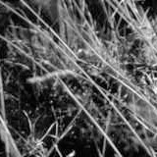
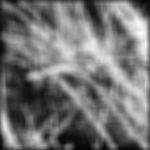
Smoothing with box filter

Slide 48
One more on board…

Slide 49
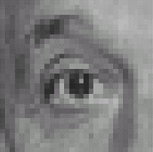
Practice with linear filters
0
0
0
?
0
1
0
0
0
0
Original
Source: D. Lowe

Slide 50
Practice with linear filters
0
0
0
0
1
0
0
0
0
Original
Filtered
(no change)
Source: D. Lowe

Slide 51
Practice with linear filters
0
0
0
?
0
0
1
0
0
0
Original
Source: D. Lowe

Slide 52
Practice with linear filters
0
0
0
0
0
1
0
0
0
Original
Shifted left
By 1 pixel
Source: D. Lowe

Slide 53
Practice with linear filters
0
0
0
-
1
1
1
?
0
2
0
1
1
1
0
0
0
1
1
1
(Note that filter sums to 1)
Original
Source: D. Lowe

Slide 54
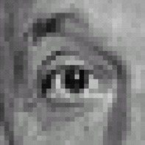
Practice with linear filters
0
0
0
-
1
1
1
0
2
0
1
1
1
0
0
0
1
1
1
Original
Sharpening filter
Accentuates differences with local average
Source: D. Lowe

Slide 55
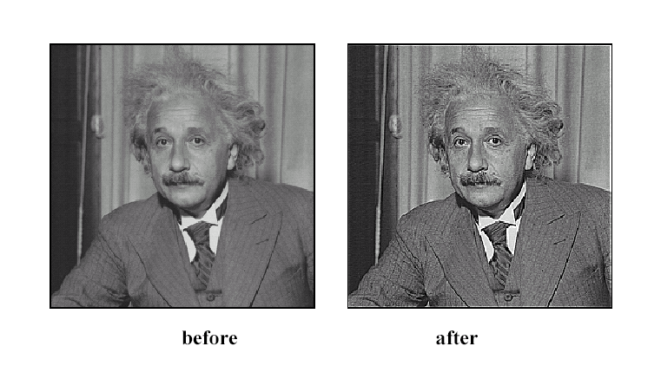
Sharpening
Source: D. Lowe

Slide 56
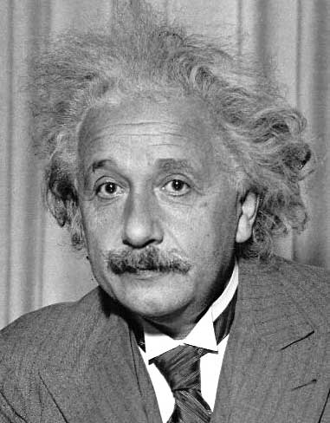
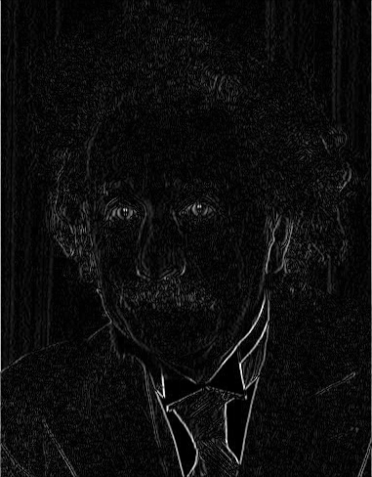
Other filters
1
0
-1
2
0
-2
1
0
-1
Sobel
Vertical Edge
(absolute value)

Slide 57
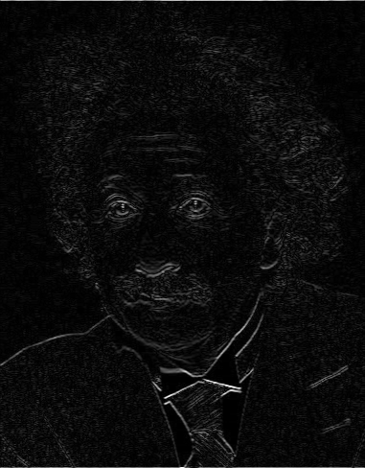
Other filters
1
2
1
0
0
0
-1
-2
-1
Sobel
Horizontal Edge
(absolute value)
Notes:
Questions at this point?

Slide 58
How could we synthesize motion blur?
theta = 30; len = 20;
fil = imrotate(ones(1, len), theta, 'bilinear');
fil = fil / sum(fil(:));
figure(2), imshow(imfilter(im, fil));

Slide 59
Filtering vs. Convolution
g=filter
f=image
2d filtering
h=filter2(g,f); or h=imfilter(f,g);
2d convolution
h=conv2(g,f);

Slide 60
Key properties of linear filters
Linearity:
filter(f₁ + f₂) = filter(f₁) + filter(f₂)
Shift invariance: same behavior regardless of pixel location
filter(shift(f)) = shift(filter(f))
Any linear, shift-invariant operator can be represented as a convolution
Source: S. Lazebnik

Slide 61
More properties
Commutative: a * b = b * a
Conceptually no difference between filter and signal
Associative: a * (b * c) = (a * b) * c
Often apply several filters one after another: (((a * b₁) * b₂) * b₃)
This is equivalent to applying one filter: a * (b₁ * b₂ * b₃)
Distributes over addition: a * (b + c) = (a * b) + (a * c)
Scalars factor out: ka * b = a * kb = k (a * b)
Identity: unit impulse e = [0, 0, 1, 0, 0], a * e = a
Source: S. Lazebnik

Slide 62
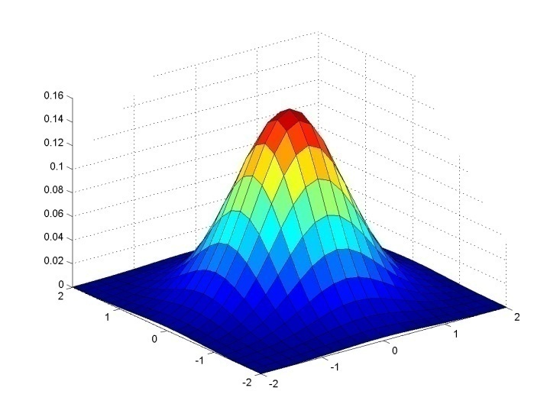
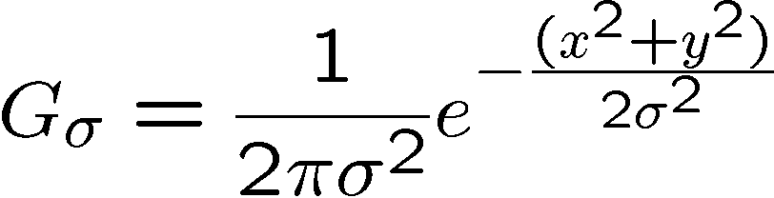
Important filter: Gaussian
Weight contributions of neighboring pixels by nearness
0.003 0.013 0.022 0.013 0.003
0.013 0.059 0.097 0.059 0.013
0.022 0.097 0.159 0.097 0.022
0.013 0.059 0.097 0.059 0.013
0.003 0.013 0.022 0.013 0.003
5 x 5, σ = 1
Slide credit: Christopher Rasmussen

Slide 63

Smoothing with Gaussian filter

Slide 64
Smoothing with box filter

Slide 65
Gaussian filters
Remove “high-frequency” components from the image (low-pass filter)
Images become more smooth
Convolution with self is another Gaussian
So can smooth with small-width kernel, repeat, and get same result as larger-width kernel would have
Convolving two times with Gaussian kernel of width σ is same as convolving once with kernel of width σ√2
Separable kernel
Factors into product of two 1D Gaussians
Source: K. Grauman
Notes:
Linear vs. quadratic in mask size

Slide 66
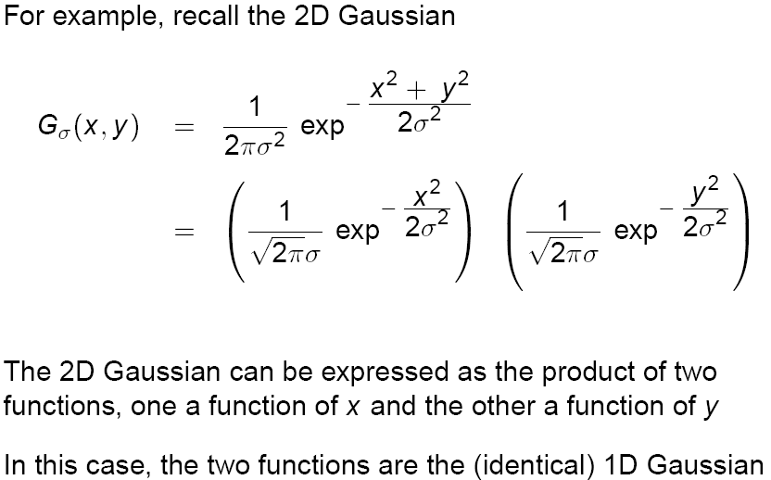
Separability of the Gaussian filter
Source: D. Lowe

Slide 67
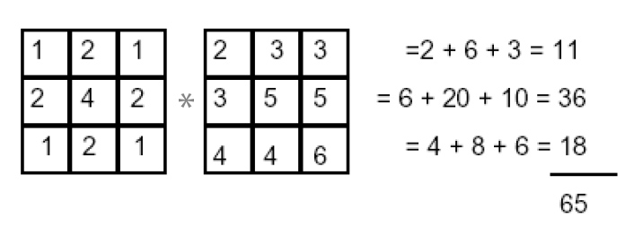
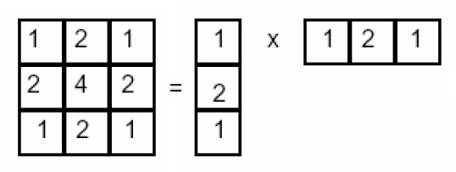
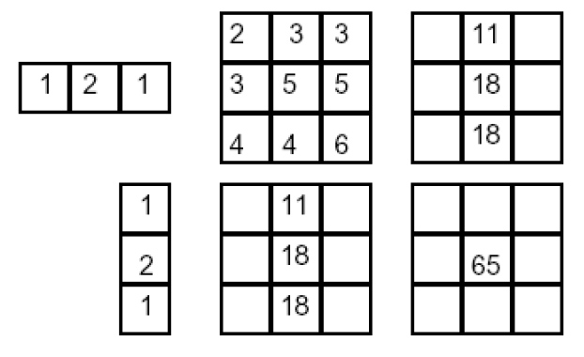
Separability example
2D convolution (center location only)
The filter factors into a product of 1D filters:
Perform convolution along rows:
*
=
Followed by convolution along the remaining column:
*
=
Source: K. Grauman

Slide 68
Separability
Why is separability useful in practice?

Slide 69
Some practical matters

Slide 70
Practical matters
How big should the filter be?
Values at edges should be near zero
Rule of thumb for Gaussian: set filter half-width to about 3 σ

Slide 71
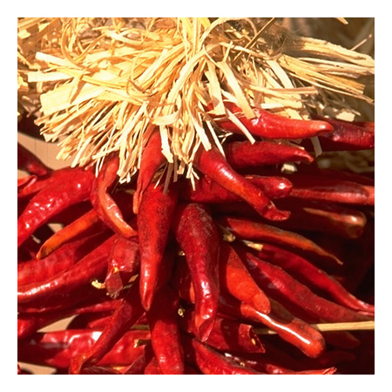
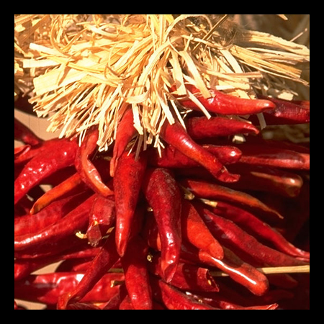

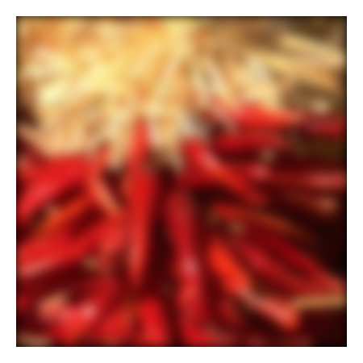
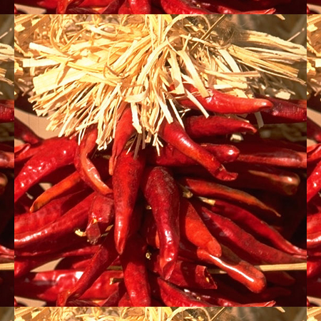

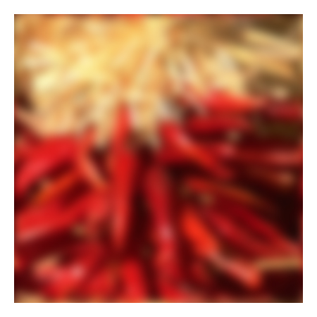



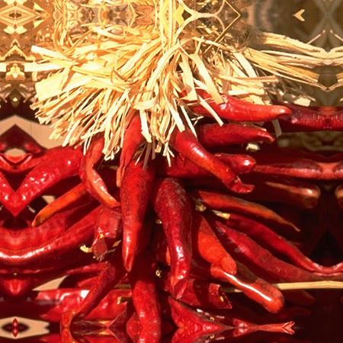


Practical matters
What about near the edge?
the filter window falls off the edge of the image
need to extrapolate
methods:
clip filter (black)
wrap around
copy edge
reflect across edge
Source: S. Marschner

Slide 72
Practical matters
Q?
methods (MATLAB):
clip filter (black): imfilter(f, g, 0)
wrap around: imfilter(f, g, ‘circular’)
copy edge: imfilter(f, g, ‘replicate’)
reflect across edge: imfilter(f, g, ‘symmetric’)
Source: S. Marschner

Slide 73
Practical matters
What is the size of the output?
MATLAB: filter2(g, f, shape)
shape = ‘full’: output size is sum of sizes of f and g
shape = ‘same’: output size is same as f
shape = ‘valid’: output size is difference of sizes of f and g
full
same
valid
g
g
g
g
f
f
f
g
g
g
g
g
g
g
g
Source: S. Lazebnik

Slide 74
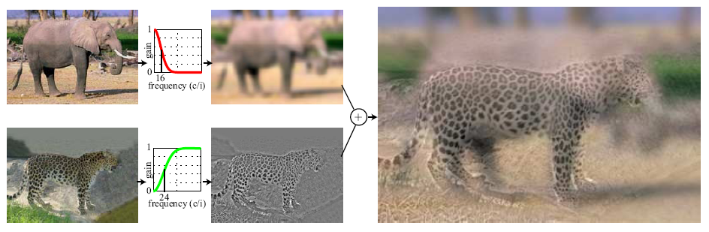
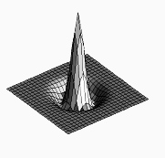

Project 1: Hybrid Images
A. Oliva, A. Torralba, P.G. Schyns, “Hybrid Images,” SIGGRAPH 2006
Gaussian Filter!
Laplacian Filter!
unit impulse
Gaussian
Laplacian of Gaussian
Project Instructions:
http://www.cs.illinois.edu/class/fa10/cs498dwh/projects/hybrid/ComputationalPhotography_ProjectHybrid.html

Slide 75

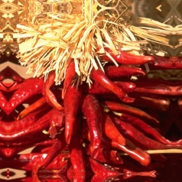
Take-home messages
Image is a matrix of numbers
Linear filtering is sum of dot product at each position
Can smooth, sharpen, translate (among many other uses)
Be aware of details for filter size, extrapolation, cropping
=
0.92 | 0.93 | 0.94 | 0.97 | 0.62 | 0.37 | 0.85 | 0.97 | 0.93 | 0.92 | 0.99
0.95 | 0.89 | 0.82 | 0.89 | 0.56 | 0.31 | 0.75 | 0.92 | 0.81 | 0.95 | 0.91
0.89 | 0.72 | 0.51 | 0.55 | 0.51 | 0.42 | 0.57 | 0.41 | 0.49 | 0.91 | 0.92
0.96 | 0.95 | 0.88 | 0.94 | 0.56 | 0.46 | 0.91 | 0.87 | 0.90 | 0.97 | 0.95
0.71 | 0.81 | 0.81 | 0.87 | 0.57 | 0.37 | 0.80 | 0.88 | 0.89 | 0.79 | 0.85
0.49 | 0.62 | 0.60 | 0.58 | 0.50 | 0.60 | 0.58 | 0.50 | 0.61 | 0.45 | 0.33
0.86 | 0.84 | 0.74 | 0.58 | 0.51 | 0.39 | 0.73 | 0.92 | 0.91 | 0.49 | 0.74
0.96 | 0.67 | 0.54 | 0.85 | 0.48 | 0.37 | 0.88 | 0.90 | 0.94 | 0.82 | 0.93
0.69 | 0.49 | 0.56 | 0.66 | 0.43 | 0.42 | 0.77 | 0.73 | 0.71 | 0.90 | 0.99
0.79 | 0.73 | 0.90 | 0.67 | 0.33 | 0.61 | 0.69 | 0.79 | 0.73 | 0.93 | 0.97
0.91 | 0.94 | 0.89 | 0.49 | 0.41 | 0.78 | 0.78 | 0.77 | 0.89 | 0.99 | 0.93
1
1
1
1
1
1
1
1
1

Slide 76
Practice questions
Write down a 3x3 filter that returns a positive value if the average value of the 4-adjacent neighbors is less than the center and a negative value otherwise
Write down a filter that will compute the gradient in the x-direction:
gradx(y,x) = im(y,x+1)-im(y,x) for each x, y

Slide 77









Practice questions
Filtering Operator
a) _ = D * B
b) A = _ * _
c) F = D * _
d) _ = D * D
3. Fill in the blanks:
A
B
E
G
F
C
H
I
D

Slide 78

Next class: Thinking in Frequency

